Slide 1

Using Moodle to Support Blended Learning
(when the Instructor is Also the pRoduction Team)
Saul Carliner, PhD, CTDP
Professor
Concordia University

Slide 2
Slides available at:
https://www.slideshare.net/saulcarliner/using-moodle-to-support-blended-learning-when-the-instructor-is-also-the-production-team

Slide 3
The problems
The material: Detail-oriented, technical lectures with lots of process-driven details
Instructor’s availability: Instructor was traveling to Australia; impossible to coordinate a live virtual session
And: Blended learning was all the rage—and I wanted to try it

Slide 4
The solution: Blending the courses
Fundamentals of Instructional Design | Administering Educational Technology Units
Purpose of the course: Level: Master’s and Graduate Diploma (cross-listed) Main objective: Given requirements, design an instructional program that addresses them. Length: 13 weeks Amount blended: Tools used: Moodle (distribution) Word Powerpoint Camtasia Library | Purpose of the course: Level: Master’s and Graduate Diploma (cross-listed) Main objective: Respond to the project, business, and people management challenges that arise in an educational technology group. Length: 13 weeks Amount blended: Tools used: Moodle (distribution) Word Powerpoint Camtasia Library

Slide 5
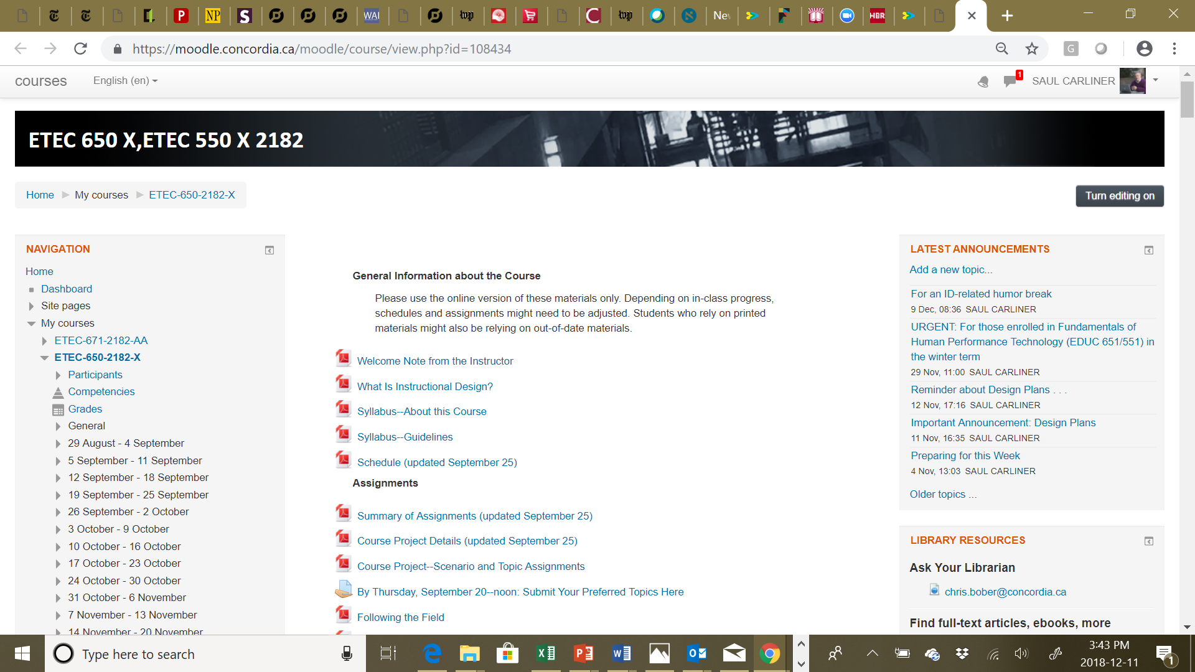
The solution on Moodle

Slide 6
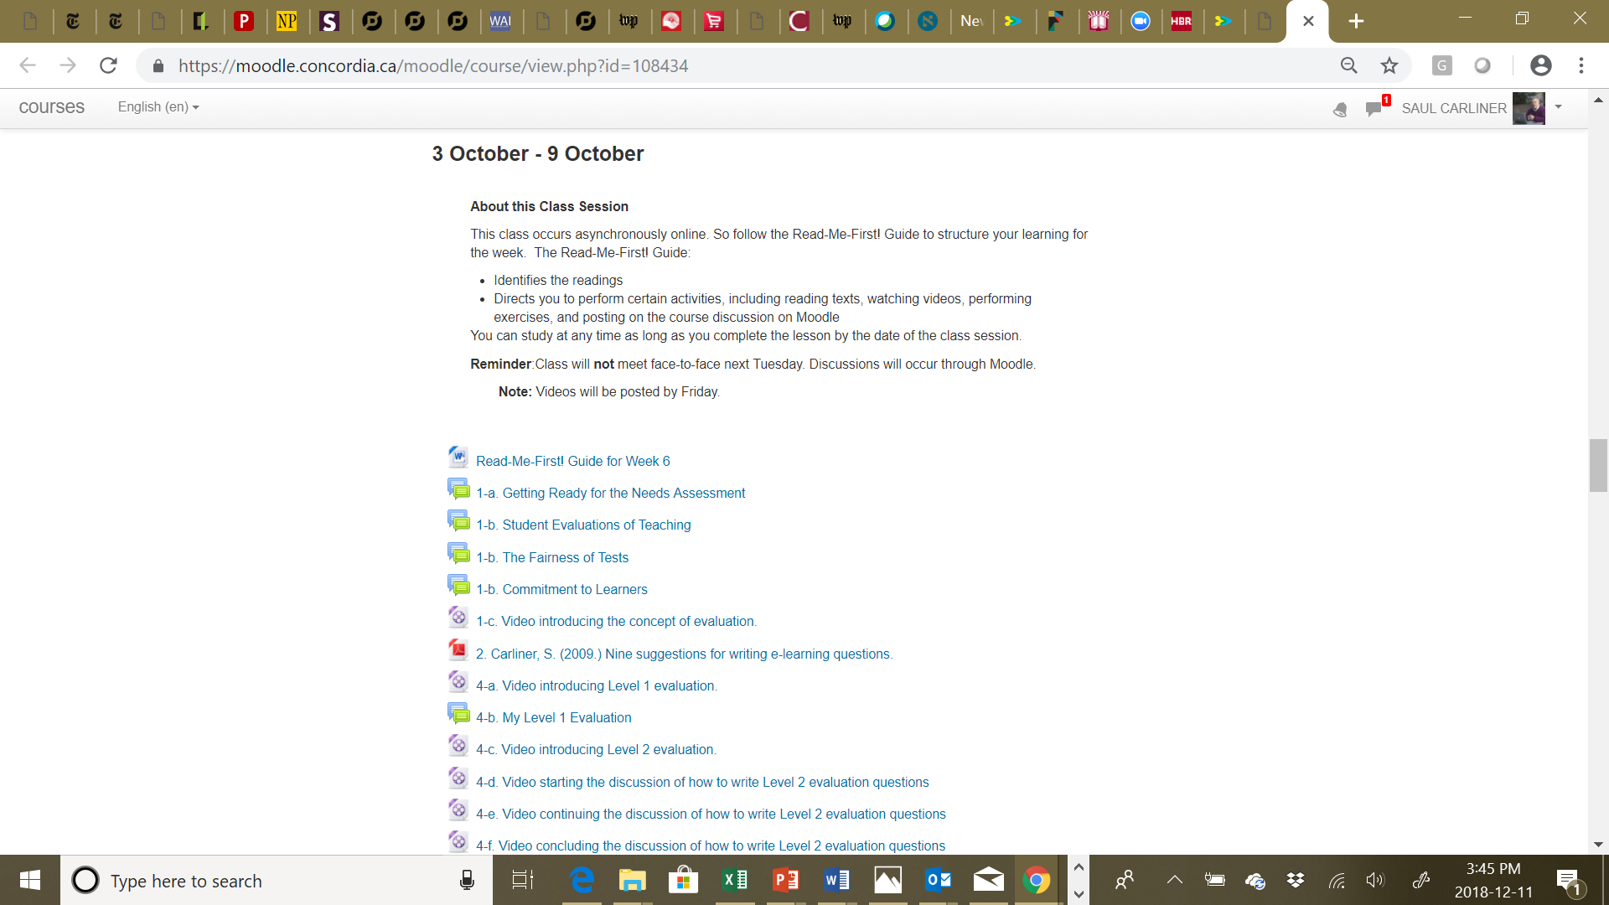
The solution on Moodle

Slide 7
The solution
Fundamentals of Instructional Design Read-Me-First! for Week 6: Summative Evaluations: The Key to Ensuring Objectives Were Met About this Lesson This session concludes the exploration of the needs assessment. It explains how to draft the instruments that assess whether or not the learning program has had the intended impact with the learners, as well as why you prepare this before you even begin to outline the instructional program, much less write it. Main Objective Given the objectives for a proposed learning program, design at least two levels of summative evaluation for an instructional program. How this Lesson Will Be Conducted Because it occurs asynchronously online, this Read-Me-First! guide will structure your learning for the week. It: Identifies the readings Guides you through the readings Directs you to perform certain activities, including watching videos, performing exercises, and posting on the course discussion on Moodle This lesson has these components. 1. Start the lesson: a. Complete a warm-up activity. b. Complete a brief pre-class activity. c. View Video 1 2. Complete the textbook readings.
Read-Me-First! Guide

Slide 8
The solution
2. Complete the two readings from the textbook. Use these guiding questions to reflect on the two readings:
(You may need to look this up on the Internet.) In the context of instructional design, what is the difference between formative and summative evaluation?
Which type of evaluations do instructional designers prepare now—before they’ve made any decisions about the instructional program?
Readings

Slide 9
The solution
In-Class Project: The Fourth Challenge In this activity, you develop an assessment for the learning program whose objectives you developed in class last week as a class activity (and no—you have not developed the lesson package). (1 of 5) To develop your assessment of reaction, adapt the sample in Training Design Basics. (2 of 5) To develop a criterion-referenced assessment of reaction, first, copy the objectives to be tested. Hints: Do all objectives need to be tested? If not, which ones do (such as entry, main, supporting, or sub-supporting)? When copying objectives, make sure to use ones emerging from the tasks presented in Read-Me-First! Guide 5.
Activities

Slide 10
The solution
2. Complete the two readings from the textbook. Use these guiding questions to reflect on the two readings:
After the class session: describe how your impressions of the following have changed: How learning programs are evaluated The ease of writing test questions What’s appropriate for exercises in learning programs? | Post your response in the forum: Changing Perceptions about Evaluation.
Also answer this question: Can we “prove” that a given learning program is effective? Why do you feel this way? | Post your response in the forum: Proving Effectiveness.
Discussions

Slide 11
Developing the solution
Guiding influences | Constraints | Time issues
Mastery learning: Engage learner Present material Demonstrate material Practice Summarize Test Webquest approach Two previous experiences designing online courses Also assumed students would like it | Assistance (or lack thereof) Tools Size limits on Moodle files | Flipped lessons prepared during the term rather than before the term

Slide 12
Process for developing the solution
Reviewed readings and slides from previous classroom session
Prepare the Read-Me-First! Guide (originally called Reading Guidesheet)
  Determine readings and order
  Prepared running case
Update slides
Record
Post

Slide 13
Administering the courses
Posting
Acclimating students to the blended environment
  Explaining in class
  Forums on the asynchronous learning experience
Monitoring discussions
  For questions
  For learning
  For participation

Slide 14

Blending the course on Moodle offers one more benefit:
Consistency of instruction.
Source: https://commons.wikimedia.org/wiki/File:Wikipedia_scale_of_justice_1.png

Slide 15
Results
 | Fundamentals of Instructional Design | Administering Educational Technology Units
Student performance | More consistent across students compared to F2F version | As good as, if not slightly better than, F2F version
Student evaluations | Overall increase, when 2/3 of the course was flipped | Increased at first
Personal assessment | Cons | Pros
 | Videos: I think the slides are too wordy The videos too long But students appreciate the clarity More challenging to: Monitor (especially forums) Maintain | More consistent instruction from year to year Helpful to second language students Forces classrooms to become more active Overall course: prefer it (especially second year)

Slide 16
Slides available at:
https://www.slideshare.net/saulcarliner/using-moodle-to-support-blended-learning-when-the-instructor-is-also-the-production-team

Slide 17
Using Moodle to Support Blended Learning
(when the Instructor is Also the pRoduction Team)
Saul Carliner, PhD, CTDP
Professor
Concordia University
saul.carliner@Concordia.ca

