Slide 1
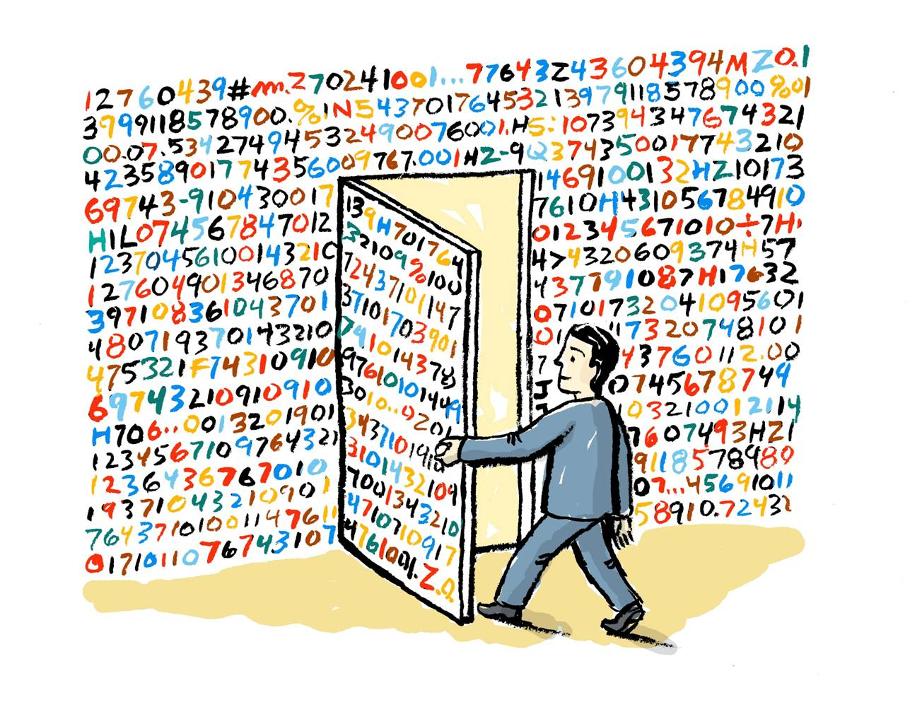
How to Use Learning Analytics in Moodle
Moodle Day 2019 May 24th, 2019
Rafael Scapin, Ph.D.
Coordinator of Educational Technology
Dawson College

Slide 2
Content
What’s Learning Analytics?
Why is it important?
Using Learning Analytics in Moodle
Questions

Slide 3
What is Learning Analytics?
Learner interaction in Moodle leaves a lot of digital traces behind.
This huge amount of aggregate data that is sourced from as many students as possible is known as Big Data.

Slide 4
What is Learning Analytics?
The measurement, collection, analysis and reporting of data about learners and their contexts, for purposes of discovering patterns, understanding and optimizing learning and the environments in which it occurs is known as Learning Analytics.

Slide 5
Big Data

Slide 6
Big Data
Diapers and Beer

Slide 7
Big Data
https://youtu.be/RC5HNTj3Dag

Slide 8
Big Data in Education
Data should be used to improve learning!

Slide 9
Big Data

Slide 10
Learning Analytics
"Learning Analytics is the use of intelligent data, learner- produced data, and analysis models to discover information and social connections for predicting and advising people's learning." George Siemens
Examples
Student dropout predictions systems
Live statistics about the learners
Individual progress vs group progress

Slide 11
Learning Analytics
Learning Analytics is the measurement, collection, analysis and reporting of data about learners and their contexts,
In order to understand and optimize learning and
the environments in which it occurs.

Slide 12
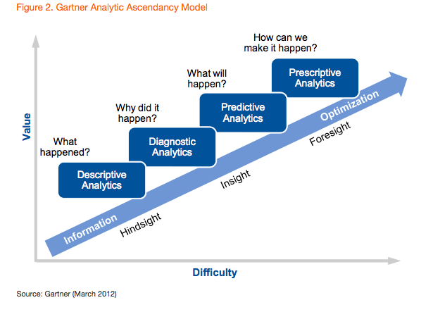
Learning Analytics

Slide 13
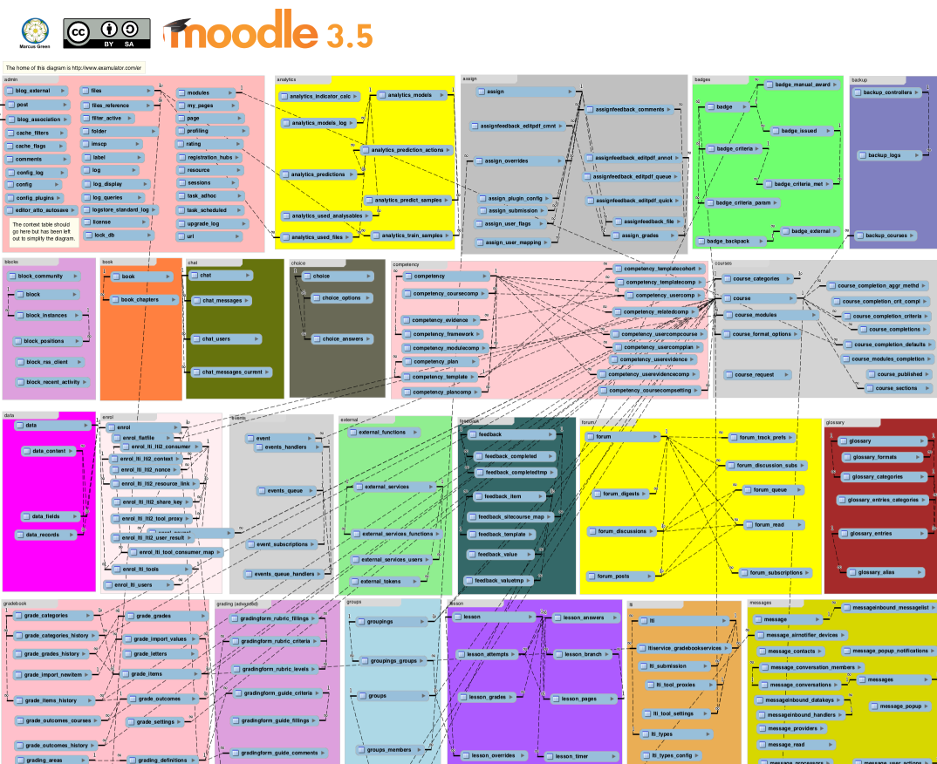
Moodle’s Database Schema
Source: https://docs.moodle.org/dev/Database_Schema

Slide 14
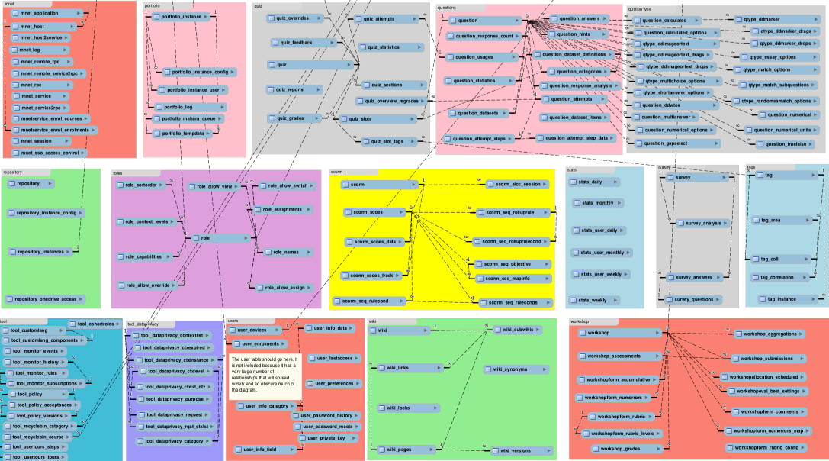
Moodle’s Database Schema
Source: https://docs.moodle.org/dev/Database_Schema

Slide 15
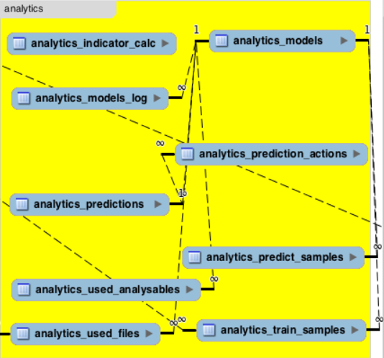
Moodle’s Database Schema
Source: https://docs.moodle.org/dev/Database_Schema

Slide 16
Learning Analytics
Horizon Report 2019
Source: https://library.educause.edu/-/media/files/library/2019/4/2019horizonreport.pdf

Slide 17
Learner-Produced Data

Slide 18
Learning Analytics: What it Can Do?
Predict future student performance (based on past
patterns of learning across diverse student bodies)
Intervene when students are struggling to provide
unique feedback tailored to their answers
Personalize the learning process for each and every student, playing to their strengths and encouraging improvement
Adapt teaching and learning styles via socialization, pedagogy and technology

Slide 19
Learning Analytics
The most common use of learning analytics is to identify students who appear less likely to succeed academically and to enable—or even initiate—targeted interventions to help them achieve better outcomes.
LA tools to identify specific units of study or assignments in a course that cause students difficulty generally. Instructors can then make curricular changes or modify learning activities to improve learning on the part of all students.

Slide 20
Learning Analytics
Much of the data on which LA applications depend comes from the learning management system (LMS), including:
log-in information
rates of participation in specific activities
•
time students spend interacting
resources or others in the class,
grades
with
online

Slide 21
Learning Analytics
Reports can take various forms, but most feature data visualizations designed to facilitate quick understanding of which students are likely to succeed.
Some systems proactively notify users; other systems require
users to take some action to access the reports.
System-generated interventions can range from a simple alert about a student’s likelihood of success to requiring at-risk students to take specific actions to address concerns.

Slide 22
Learning Analytics

Slide 23
What Learning Analytics Can’t Do?
Data from tracking systems is not inherently intelligent
Hit counts and access patterns do not really explain anything.
The intelligence is in the interpretation of the data by a skilled analyst.
Ideally, data mining enables the visualization of interesting data that in turn sparks the investigation of apparent

Slide 24
What Learning Analytics Can’t Do?
Another thing analytics can not do by themselves is
improve instruction
While they can point to areas in need of improvement and they can identify engaging practices, the numbers can not make suggestion for improvements.
This requires a human intervention – usually in the form of a focus group or by soliciting suggestions from the learners themselves.

Slide 25
Learning Analytics Outcomes
Prediction purposes, for example to identify 'at risk' students
in terms of drop out or course failure
Personalization & Adaptation, to provide students with tailored learning pathways, or assessment materials
Intervention purposes, providing educators with information to intervene to support students
Information visualization, typically in the form of so-called learning dashboards which provide overview learning data through data visualisation tools

Slide 26
((})
•

Slide 27
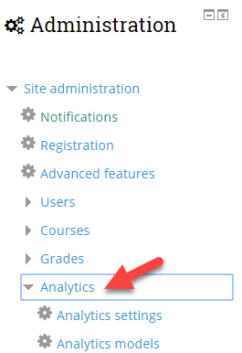
Learning Analytics in Moodle

Slide 28
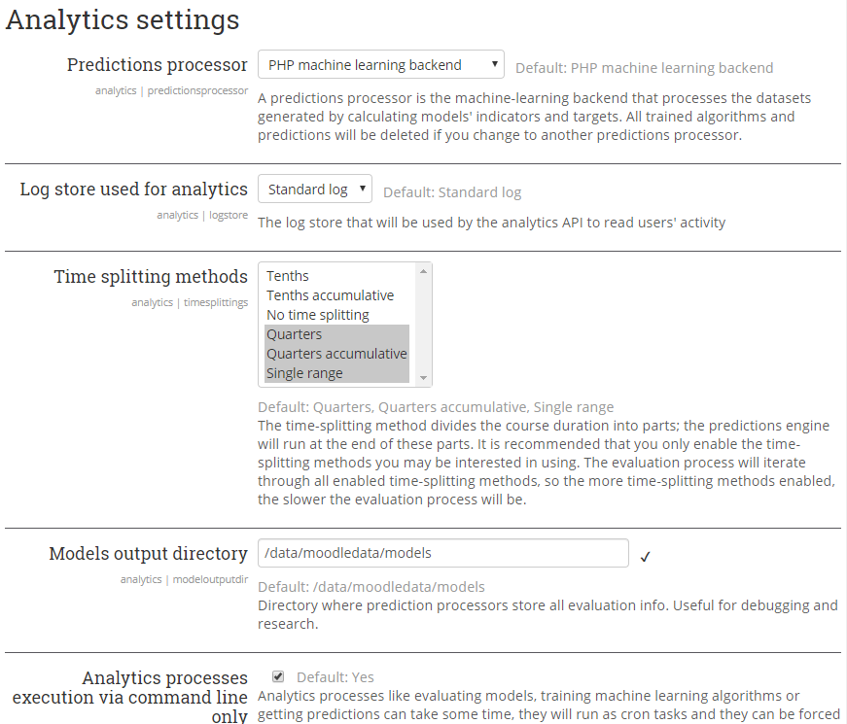
Learning Analytics in Moodle

Slide 29
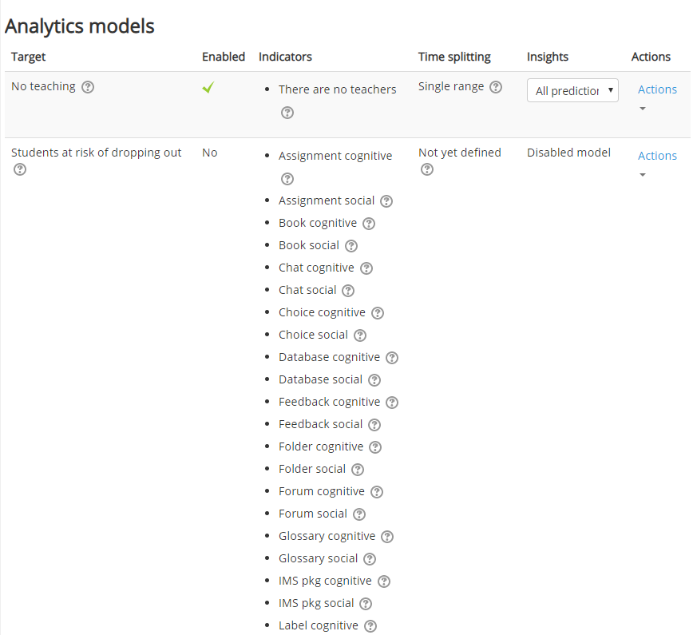
Learning Analytics in Moodle

Slide 30
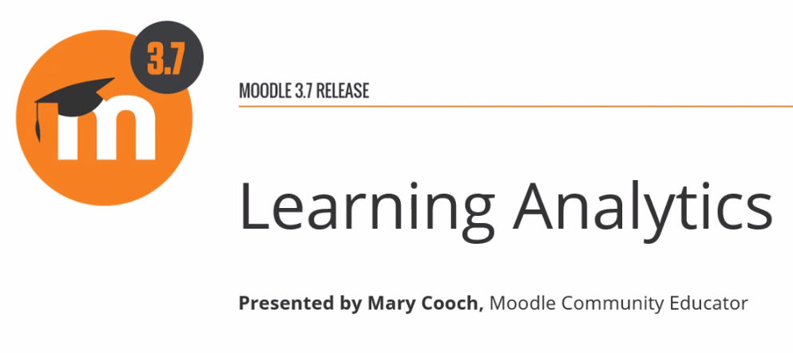
Learning Analytics in Moodle 3.7
https://www.youtube.com/watch?v=UHwfG6q9UsA

Slide 31
Analytics & Reports in Moodle
1. Moodle’s Native Learning Analytics Tool
(Inspire Analytics)
Beginning in version 3.4, Moodle core now implements open source, transparent next-generation learning analytics using machine learning backends that go beyond simple descriptive analytics to provide predictions of learner success, and ultimately diagnosis and prescriptions (advisements) to learners and teachers.
In Moodle 3.4, this system ships with two built-in models:
Students at risk of dropping out
No teaching activity
The system can be easily extended with new custom models, based on reusable targets, indicators, and other components. For more information, see the Analytics API developer documentation.
https://docs.moodle.org/36/en/Analytics

Slide 32
Learning Analytics in Moodle
https://youtu.be/Qyp0tIsC714

Slide 33
Intelliboard
https://intelliboard.net/

Slide 34
Intelliboard
https://youtu.be/LimkbhWFMS4

Slide 35
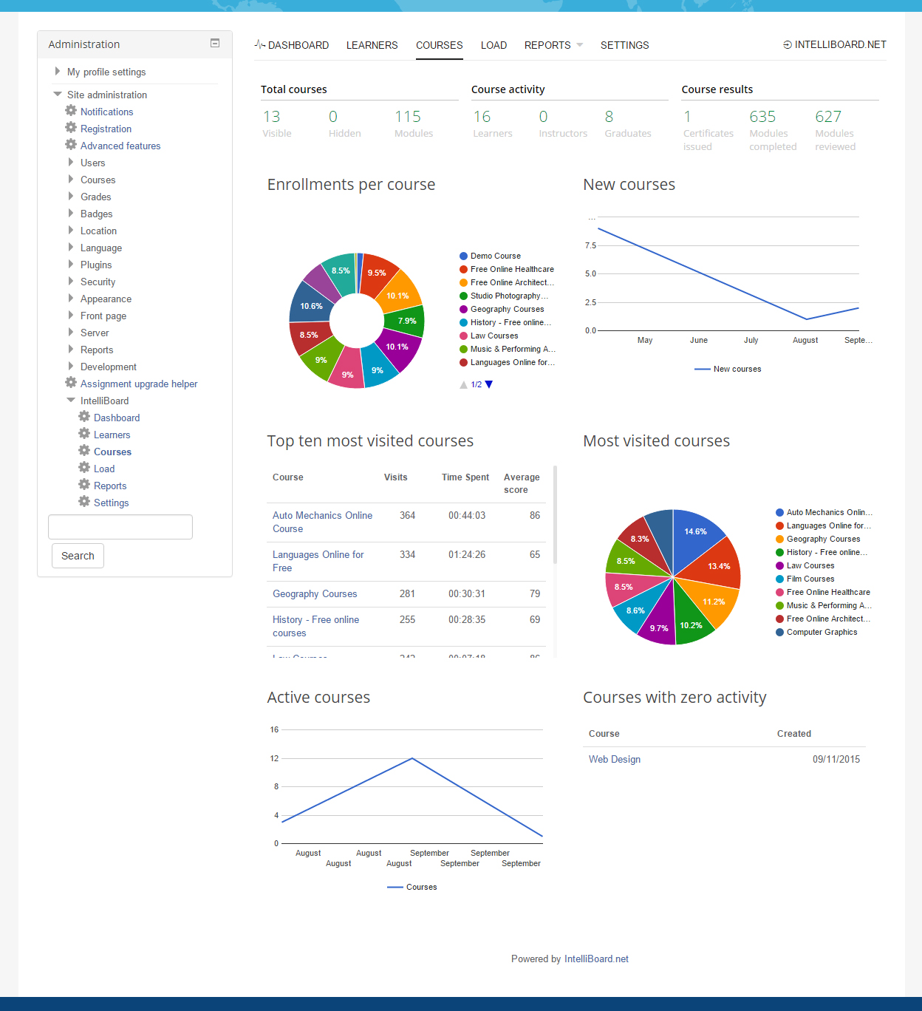
Intelliboard

Slide 36
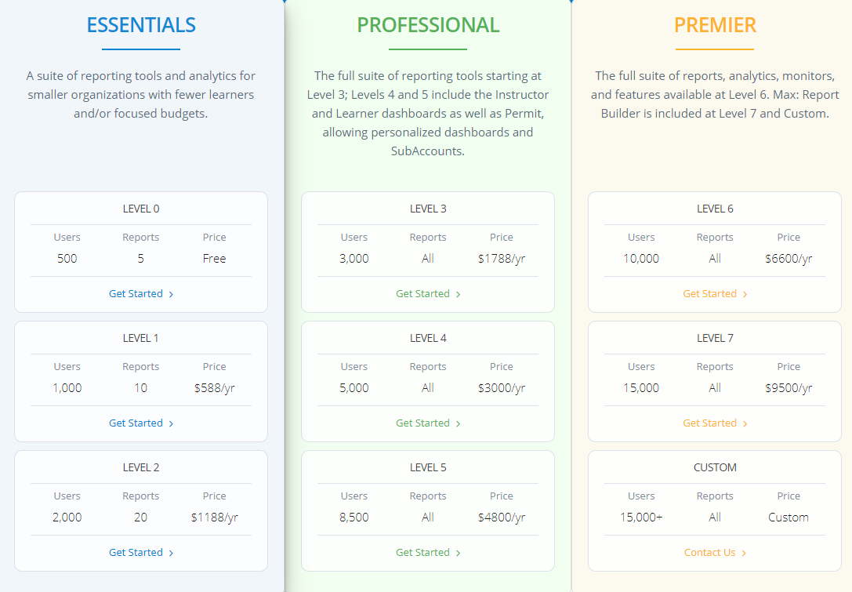
Intelliboard
https://intelliboard.net/pricing

Slide 37
Zoola
https://www.zoola.io/

Slide 38
Zoola
https://youtu.be/XYBhEJEds8E

Slide 39
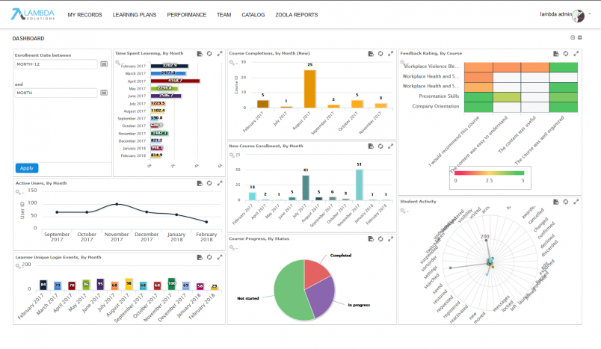
Zoola

Slide 40
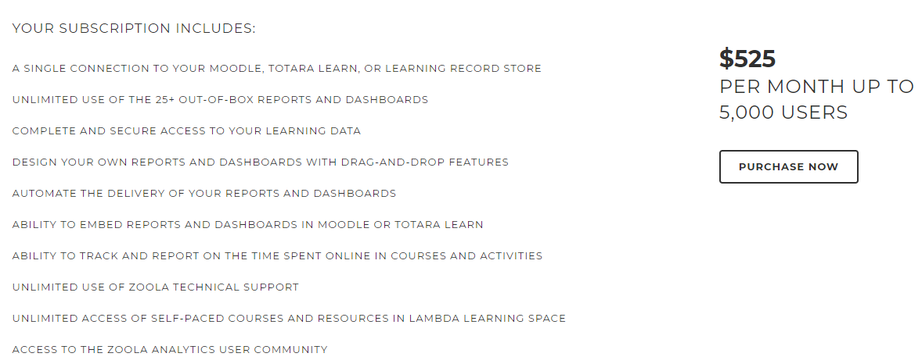
Zoola
https://www.zoola.io/pricing/

Slide 41
Resources
Moodle Learning Analytics Work Group
https://moodle.org/course/view.php?id=17233#section-6
Moodle Learning Analytics FAQ
https://docs.moodle.org/37/en/Moodle_Learning_Analytics_FAQ

Slide 43
Contact
Rafael Scapin, Ph.D.
rscapin@dawsoncollege.qc.ca
http://dawsonite.dawsoncollege.qc.ca

