Slide 1
eLearning Courses in the Healthcare Sector

Slide 2
Introduction
Jason Maur
Chef de service, Formation continue partagée
Centre universitaire de santé McGill

Slide 3
Overview
How we use Moodle in the context of healthcare
Different tools and standards we use
What does a fully autonomous course look like?
Supplementary materials
Future plans

Slide 4
Our Reality

Slide 5
Autonomous
No moderators nor teachers
No human feedback
Rely on SCORM modules

Slide 6
What is SCORM?
Shareable
Content
Object
Reference
Model

Slide 7
What is SCORM?

Slide 8
We’re Binary
You either did it or you didn’t (1 or 0)
Notes:
https://www.flickr.com/photos/christiaancolen/20607150556

Slide 9
Time is hard to come by
We work in a hospital!
Unionized environment
Learners need to be liberated and compensated for their time

Slide 10
Older Clientele

Slide 11
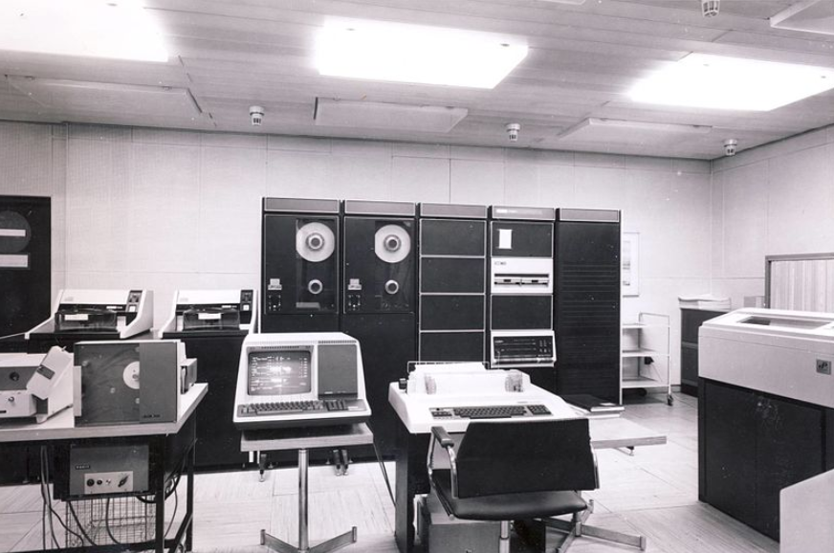
Not terribly computer saavy

Slide 12
Reeling in the SMEs

Slide 13
Real-world Examples

Slide 14
Job Aids and Promotional Materials

Slide 15
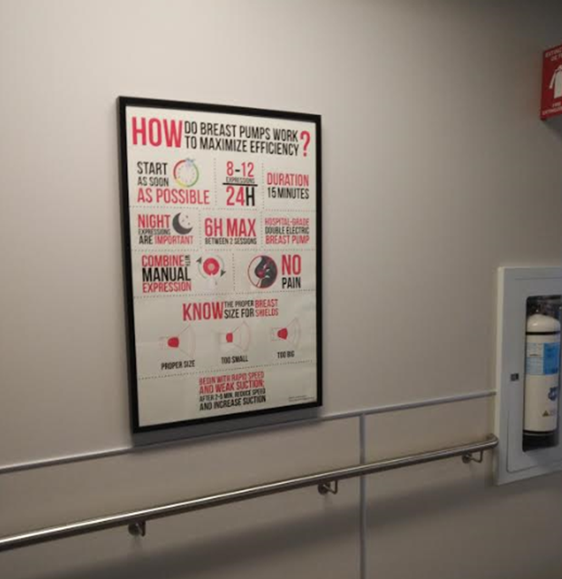
Milk Expression in the NICU

Slide 16
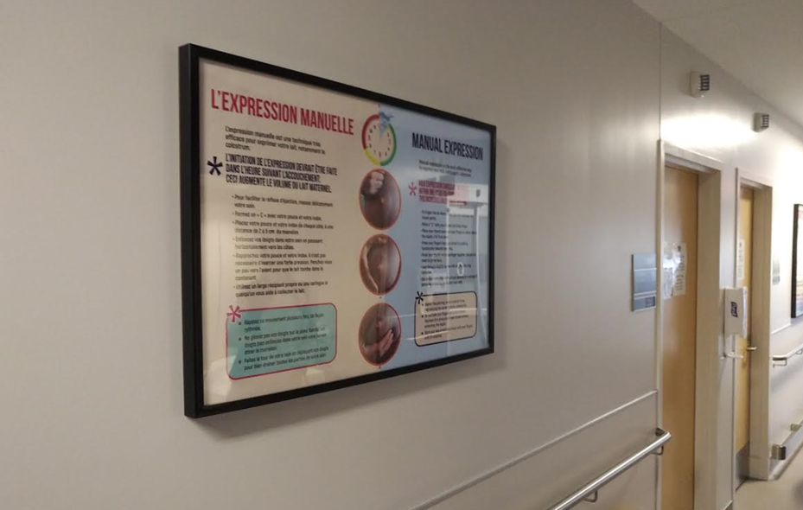
Milk Expression in the NICU (cont’d)

Slide 17
Promotional Posters

Slide 18
H5P and Plans for the Future

Slide 19
QUESTIONS?

