Slide 1
New features in Moodle
From 3.4 to 3.6

Slide 2
GDPR compliance
Age of consent
Data request interface for users (for export or deletion)
Plugin privacy tool showing where private data is stored in Moodle
Site policies management
User agreement management

Slide 3
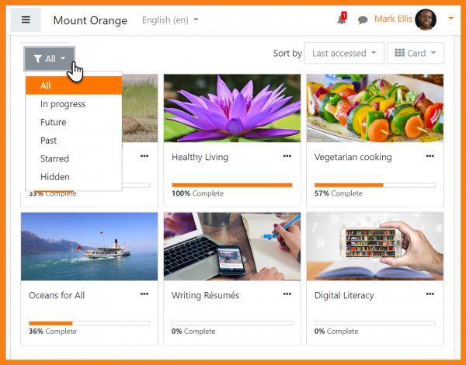
New Dashboard
Notes:
Vidéo:
http://flizotte.profweb.ca/video/2019-05-23_13-35-46.mp4

Slide 4
New Dashboard

Slide 5
With a timeline

Slide 6
New icons

Slide 7
Audio and video recording

Slide 8
Better user management

Slide 9
Badge based on badges

Slide 10
Filter questions with tags

Slide 11
Tagging questions and filtering

Slide 12
New global search

Slide 13
Messaging improvements

Slide 14
Add files in assignment feedback comments

Slide 15
Sources
Most images from Moodle.org community site
For more details about Moodle releases
https://docs.moodle.org/dev/Moodle_3.6_release_notes
https://docs.moodle.org/dev/Moodle_3.5_release_notes

