Slide 1


Inclusive online learning
A critical overview
Paul Turcotte
Teacher, département de philosphie, Cégep du vieux Montréal
Researcher, CRISPESH

Slide 2
What is inclusive teaching?
Social model of disability
  « The social model considers disability as the interaction between the individual and his environment. In the social model the approach to disability related problems is to change the interaction between the individual and the environment; in other words, to design the educational environment to be as inclusive as possible. » - Dawson Web Site

Slide 3
In this model, what creates disability?
Disability | Cause (in the environment)
Reading / writing difficulties | Time limit Impossibility of using technological tools (paper documents, unavailability of said tools) Stressful environment
Physical accessibility | Physical environment
Etc.

Slide 4
How to design an inclusive online learning environment?
In some regards, online learning environments are intrinsically inclusive.
  In an asynchronous environment, many elements that may initiate disability are not present: time limits, fixed schedule, evanescence of the teacher’s performance, paper documents.
  In a synchronous environment: the time issues come back, but many issues related to space are attenuated. Plus, the advantages of digital documents are present.

Slide 5
Online learning and UDL
Universal Design for Learning
UDL guidelines
Online learning offers many possibilities

Slide 6
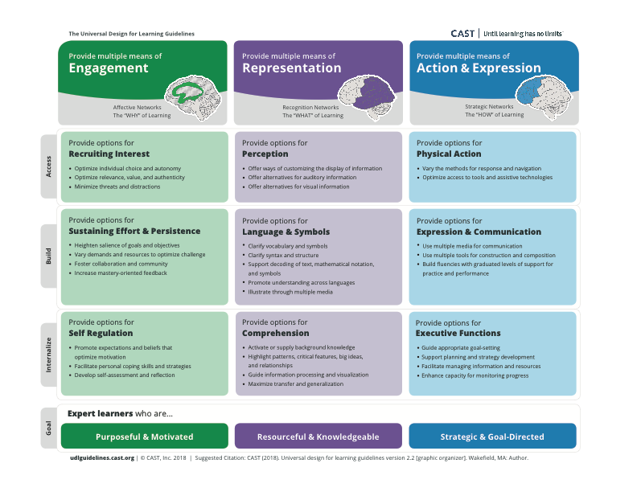
Online learning and UDL

Slide 7
New barriers, new solutions
Digital fracture, again. (Burgstahler, 2005)
  Access to computers or the Internet (1st fracture)
  Access to accessible content
    Exemples:
      Videos: subtitled, resumed
      Web accessibility norms
Digital agility (Seale, Draffan et Wald, 2010).
  Empowerment through personalization; “hack culture”

Slide 8
Research at CRISPESH
PERFORMA grant : Pour un usage inclusif des TICE.
PAREA: project for 2019.

Slide 9
Thank you!
Paul Turcotte
pturcotte@cvm.qc.ca
Powerpoint here:

