Slide 1
E-feedback does it work? Is it for me?
Stéphanie Facchin, Ph. D.
Cégep à distance
Dawson E-learning Community of Practice
7th may 2018, Montreal, QC, Canada
Notes:
Good morning, enjoy your meal.
My name is Stephanie Facchin, I’m a researcher at cegep à distance. And I am glad to present the results of a research that I did to evaluate the effect of giving e-feedback on achievement, persistence and learners’ satisfaction.
This study took place at Cégep à distance wich is a dedicated distance education college in the province of Quebec in Canada. Yearly, the number of registrations exceeds 20 000 (twenty thousand).
In our institution, as in many distance education institutions, we are concerned about course dropout.
Litterature has clearly demonstrated that feedback is an important factor related to persistence and success. Also, available technologies multiply the possibilities of giving feedback to learners and are an opportunity to innovate.
Therefore, we developped a research project where learners receive e-feedback : it is either audio feedback, video feedback or feedback using Skype conference software.

Slide 2
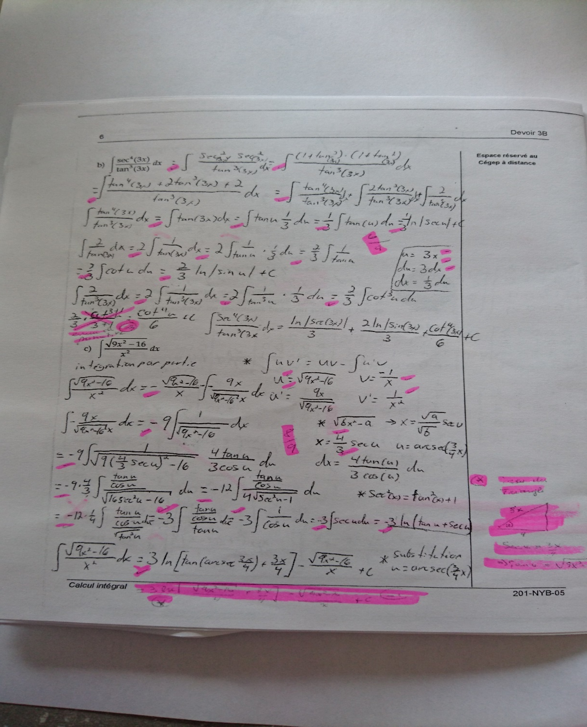
Notes:
But why we were interested in e-feedback because of this in fact!
Here is an example of traditional written copy with comments on it.
One of the problems with written feedback is that you have limited space. You can not write everything you want to the students. So what happened is that feedback is limited to task correction. In fact, this is what I found in a study where we coded for contents of feedback.

Slide 3
Feedback levels in assignments
Facchin, S. (Manuscrit en préparation). Feedback in distance education: What’s in it for my grade?
Hattie, J., & Timperley, H. (2007). The power of feedback. Review of Educational Research, 77(1), 81-112
Rodet, J. 2000. La rétroaction, support d’apprentissage ? Revue du Conseil Québécois de la Formation à Distance, 4(2), 45-74.
Notes:
We found that the majority of comments on copy were at the task level. It informed the student how well a task is being performed such as correct incorrect answers. This type of feedback is not generalize to others tasks contrary to process feedback or self regulation feedback

Slide 4
Feedback definition
All the information provided to the learner by his teacher, as to his academic achievements or his understanding of the subject, when correcting evaluations. It aims to improve learning, persistance and academic success.
(Facchin, 2018, p. 14)
Notes:
So what I mean by feedback is

Slide 5
Why giving e-feedback?
Written feedback: takes time, space and learners have troubles to read or to understand what it is meant
E-feedback:
Less time consuming
More feedback
Facilitates appropriation
Richer feedback
Learners more satisfied but is there an impact on academic results?
More social presence feeling
Mixed results and few quantitative studies with experimental design
Ackerman, D. S., & Gross, B. L. (2010). Instructor feedback: How much do students really want? Journal of Marketing Education, 32(2), 172-181.
Arbaugh, J. B., Cleveland-Innes, M., Diaz, S. R., Garrison, D. R., Ice, P., Richardson, J. C., & Swan, K. P. (2008). Developing a community of inquiry instrument: Testing a measure of the community of inquiry framework using a multi-institutional sample. The Internet and Higher Education, 11(3), 133-136.
Ford, S. (2015). The Effects of Written and Video/Audio Communication on Learners’ Perceived Feelings of Connectedness, Course Satisfaction, Participation, and Achievement in an Online Community College Algebra Course. Texas Tech University.
Ice, P., Curtis, R., Phillips, P., & Wells, J. (2007). Using Asynchronous Audio Feedback to Enhance Teaching Presence and Students' Sense of Community. Journal of Asynchronous Learning Networks, 11(2), 3-25.
Johnson, G. M., & Cooke, A. (2016). Self-regulation of learning and preference for written versus audio-recorded feedback by distance education students. Distance Education, 37(1), 107-120.
Macgregor, G., Spiers, A., & Taylor, C. (2011). Exploratory evaluation of audio email technology in formative assessment feedback. Research in Learning Technology, 19(1), 39-59.
Mathisen, P. (2012). Video feedback in higher education, - A contribution to improving the quality of written feedback. Nordic Journal of Digital Literacy, 7(2), 93-117.
Roberge, J. (2008). Rendre plus efficace la correction des rédactions. Rapport de recherche PAREA. Montréal, QC : Cégep André-Laurendeau.
Wade, N. N. (2016). The Face Of Feedback: Exploring The Use Of Asynchronous Video To Deliver Instructor Feedback In Multidisciplinary Online Courses. (Doctoral dissertation), Wayne State University.
Notes:
Several studies have demonstrated that written feedback is time and space consuming and that learners do not read it or have troubles to simply understand what the comments mean.
On the other hand, there are studies who have reported that e-feedback allows for more comments, takes less time to produce, is easier to understand and is more personal for learners.
However, evidences are mixed in distance education:
Ford (2015) found no significant effect of audio or video feedback on achievement and satisfaction, but learners perceived that it was helpful in creating a sense of connectedness with the instructor and the other learners in the course.
Johnson and Cooke (2016) report that learners do prefer written over audio-recorded feedback, but Ice, Curtis, Phillips, and Wells (2007) found the exact opposite.
Wade (2016), in a qualitative research, found more positive results: learner and instructor perceived video feedback as useful and have the ability to reduce distance between them.
Following this review, we concluded that very few studies have measured the direct impact of e-feedback on academic achievement. Also, they seldom have compared several technological means between them. And they have seldom been done in a distance education setting with an experimental design that includes a large sample.

Slide 6


What was tested and why?
<
<
<
574 E-feedbacks
62%
N = 236 experimental group
N = 114
control group
23 years
(SD = 6.2)
Notes:
So, we designed a quasi-experimental study to compare the impacts of e-feedback (audio, video, visioconference) on academic achievement, persistence and learners’ satisfaction in distance education.
More than 500 learners were enrolled in the study and we had 236 learners in the experimental group, the mean age was 23 (twenty three) and 62 % (sixty two pourcent) of the subjects were male.
All in all, our tutors gave 574 (five hundred and seventy four) e-feedbacks.
Différence significative à .05 pour l’âge. 23 ans pour les D+ et 21 pour le groupe contrôle.
Pas de différence significative en ce qui concerne le genre ni le statut (47% admis et 53% en commandite)

Slide 7
Effect on achievement and on drop out rates
Lower dropout rate (36% vs 44%)
Higher success rate (47% vs 39%)
Same failure rate (17%)
Notes:
As expected, the experimental group had a significantly a lower drop out rate than the control group.
The success rate is significantly higher in the experimental group than in the control group.
On the other hand, the failed rate is higher in the experimental group.
So what happended? In fact, e-feedback did have a positive effect on drop out and success but the rate of students who failed also inscreased.
Those who drop out because of difficulties with the subject failed the course while those who drop out because of motivation went out to succeed in the course.
In the experimental group, we suspect that e-feedback had a motivational impact on some learners who were encouraged to get through the course but still have difficulties with the subject. So those learners would had probably drop out the course otherwise.
What we also found is that audio got good results but the results for video are mixed. With one tutor it went very well but for the other, the failed rate is quite higher and the success rate is also rather low.
Those results stike us. It may be due to course difficukties. The tutor who gave the feedback in the hardest course also had the lowest results.

Slide 8
Significant effect (winter session)
Drop out
Failure
Success

Slide 9
Significant differences on grades
**
**
F (1, n = 177) = 9.41, p = .01
F (1, n = 177) = 6.17, p = .01
Notes:
We also found significant differences on grades for the first and the fourth assignment but not for the final course grade even if the e-feedback group still had better grades.
Those results mean that it takes several feedbacks to observe a significant improvment beyond the motivational effect we observed for the first assignment.

Slide 10
Audio for success and video for dropout
Drop out
Failure
Success

Slide 11
Learners’ satisfaction
Preference for video feedback
It is a faster way to hear about your work
It really allowed me to understand my mistakes and to correct myself for the exam.
This is of course due to the fact that Devoir + is still at a young stage, but it would be nice to film the assignment and point out errors at the same time that the tutor explains the mistakes I made. So, it would be as if our teacher was next to us. (learners with audio only)
Access to feedback
Sound or image quality (Camera Ziggy)
Good Internet service
Download file rahter than streaming
Notes:
On the learners’ side, we found that the majority of them prefer a combination of video and written feedback and the second choice is a preference for a combination of audio and written feedback.
The majority of them are also rather satisfied with e-feedback.
On the positive side, they noted that it is a faster way to hear about their work, it really allowed to undertstand why they did wrong and to correct it.
On the negative side, it is mostly about technology. Some recordings were of a poor sound and image qualities.
The recording were also difficult to find because they had to access the Learning management system which is not very intuitive.

Slide 12
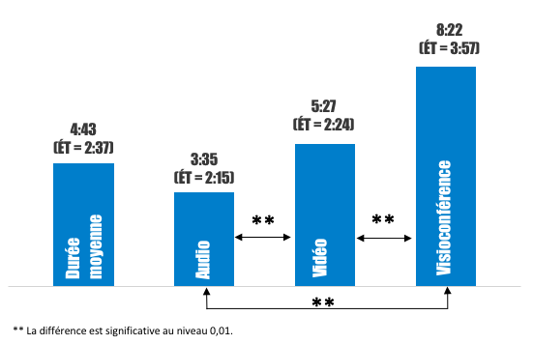
E-feedback duration
Notes:
E-feedback takes times but is it really the same? Need to have IT tools to register.

Slide 13
Good practices for e-feedback
To foster listening and receptivity:
Be brief, no more than 5 minutes
Start with salutation
Clearly indicate where your comments relate to
Sum up good points and weaknesses
End with a question to invite student to reflect
Be natural!
To foster editing process:
Quiet place
Prepare your comments before strating recording
Do not spend time on redoing your recording
Ensure to have a good speed of Internet connection
Keep a copy of your recording and name the file with a unique code pertaining to each learners
To foster the effect of feedback on academic results:
Feed Up (where I am going?), Feed Back (How I am going?), Feed Forward (Where to next?) (Hattie & Timperley, 2007)
Go further than academic correction
Give explanations on why it is wrong and right
Give examples
Specify if the goals (competencies) are achieved
Comments also have to be related to the task rather than on the motivational side only
Notes:
Before starting the experiment we also had derived from littérature some good practices that we applied in this project. I do not have time here to go through all of them but, Please send me an email if you to have them.

Slide 14
Finally
As E-feedback is within everyone’s reach and give siginificant results on academic achievement,
E-feedback is on the way to become a sustainable practice within our new tutoring system.
BUT
Always remember that it is the content of feedback that makes the difference rather than the medium you use to convey your message!
Notes:
Finally, I would say that e-feedback has impact on academic results. Since it is within everyone’s reach, the use of e-feedback in our institution is now started to be used outside this research project.
I would end up by stating that it is what you put inside your feedback that makes the difference more than the medium you use to convey your message!
Thank you.

Slide 15
Comments
Questions
What about you?

Slide 16
Thank you
To go further : http://cegepadistance.ca/accueil-reseau-education/la-recherche-au-cegep-a-distance/
sfacchin@cegepadistance.ca

Slide 17
Impact sur le travail de tuteur
Prise de rdv Skype par messagerie (aller et retour).
Appropriation des logiciels.
Ajout de tâches supplémentaires: numérisation du devoir.
Nécessite une bonne vitesse pour le transfert sur Internet pour téléverser.
Skype: obligation d’être présent en même temps, demande de la disponibilité.
Retarde le traitement du devoir.
Difficile de trouver un moment tranquille.
Difficile de s’en tenir à 5 min.
Gestion des fichiers.
Décourager par les problèmes de dépôt des fichiers.
Permet d’apporter des précisions sur les erreurs et ce qui est attendu.
Personnalisation de la rétroaction.
Facilite la création d’une relation (plus de messages de la part des apprenants Devoir+).
Sentiment d’être plus près des étudiants.
Continuité entre les correction et les rétroactions car on peut retrouver les anciennes rétroactions.
Gratification de la part des étudiants.
Meilleure communication (plus et plus ciblée).

